Slide 1
DataBASE MANAGEMENNT LAB1
GROUP MEMBERS:
-AYMANE JAWADI -KARAM MOHAMMED -AMINE IMAKOR

Slide 2
SUMMARY OF THE POWERPOINT
In order to not get things messy and unreadable the diagram will be divaded into different parts resembling each major entities and at the end all of them will be regrouped into one starting with.
PERSON
LABORATORIES
RESEARCH PROJECT
BUDGET
EQUIPMENT MODELS AND EQUIPMENT UNITS
CERTIFICATION AND AUTORIZATIONS
RESERVATIONS
MAINTENANCE
CALIBRATION RECORDS
CONSUMMABLE

Slide 3
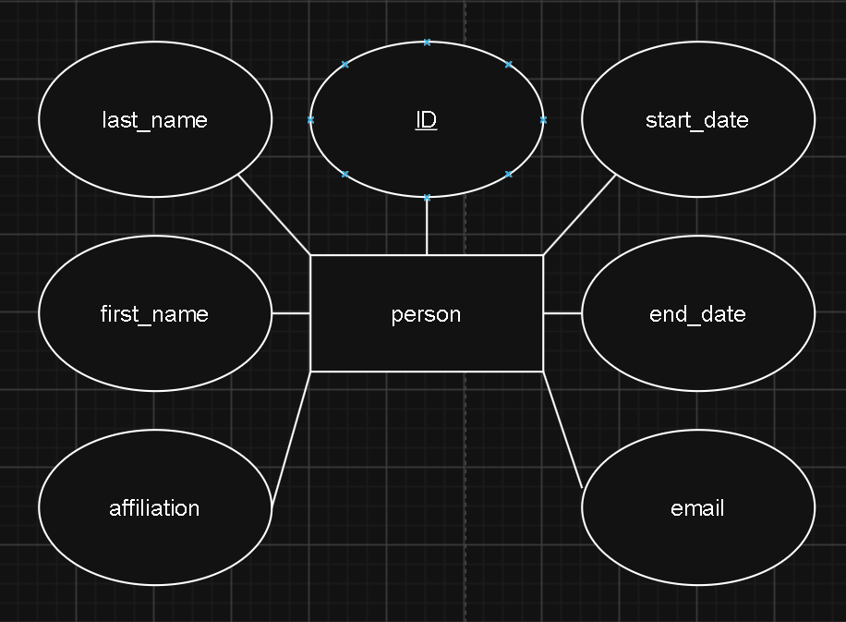
PERSON

Slide 4
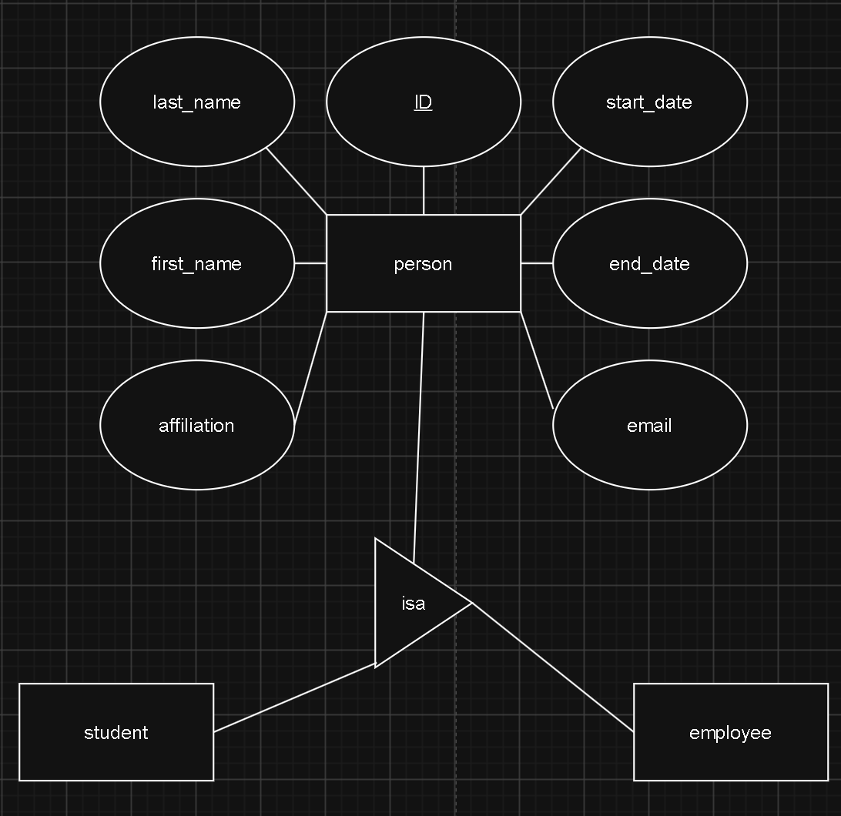
PERSON

Slide 5
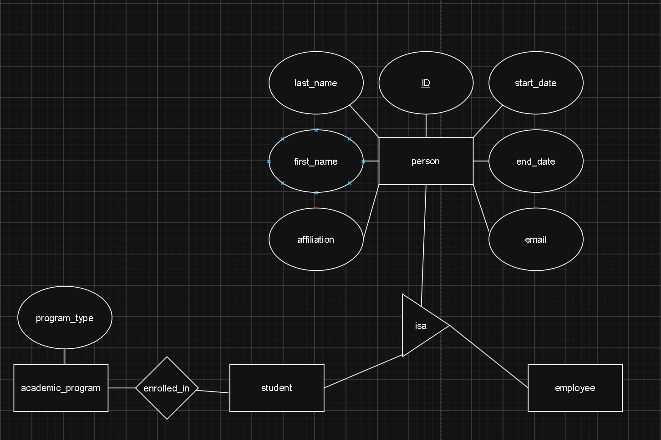
PERSON

Slide 6
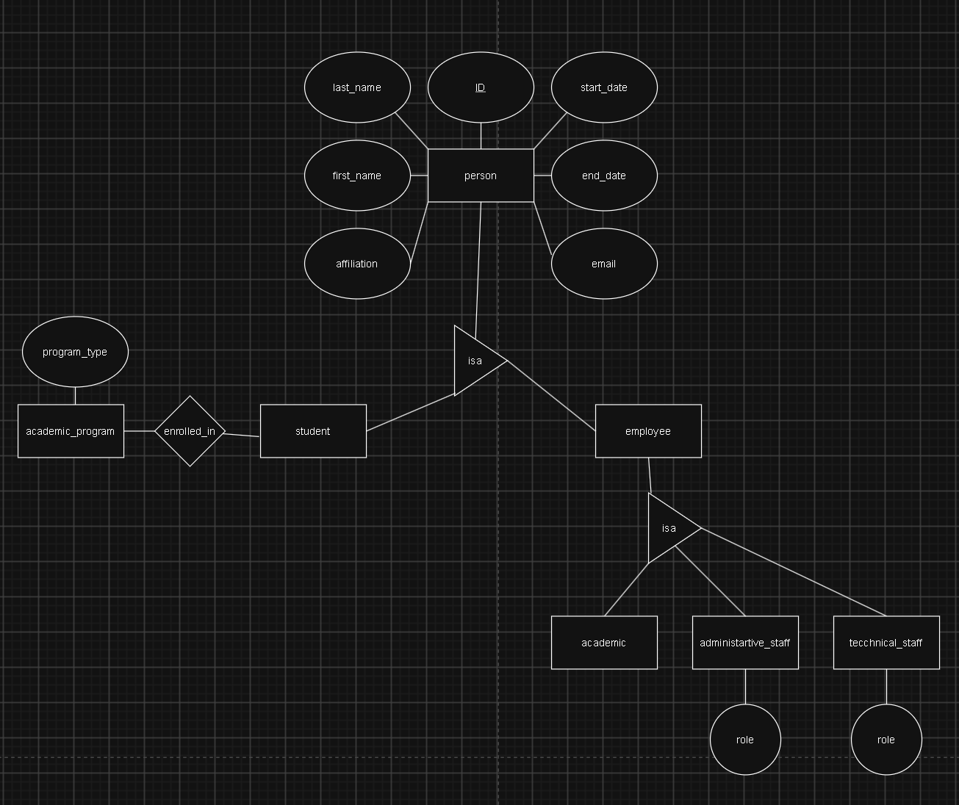
PERSON

Slide 7
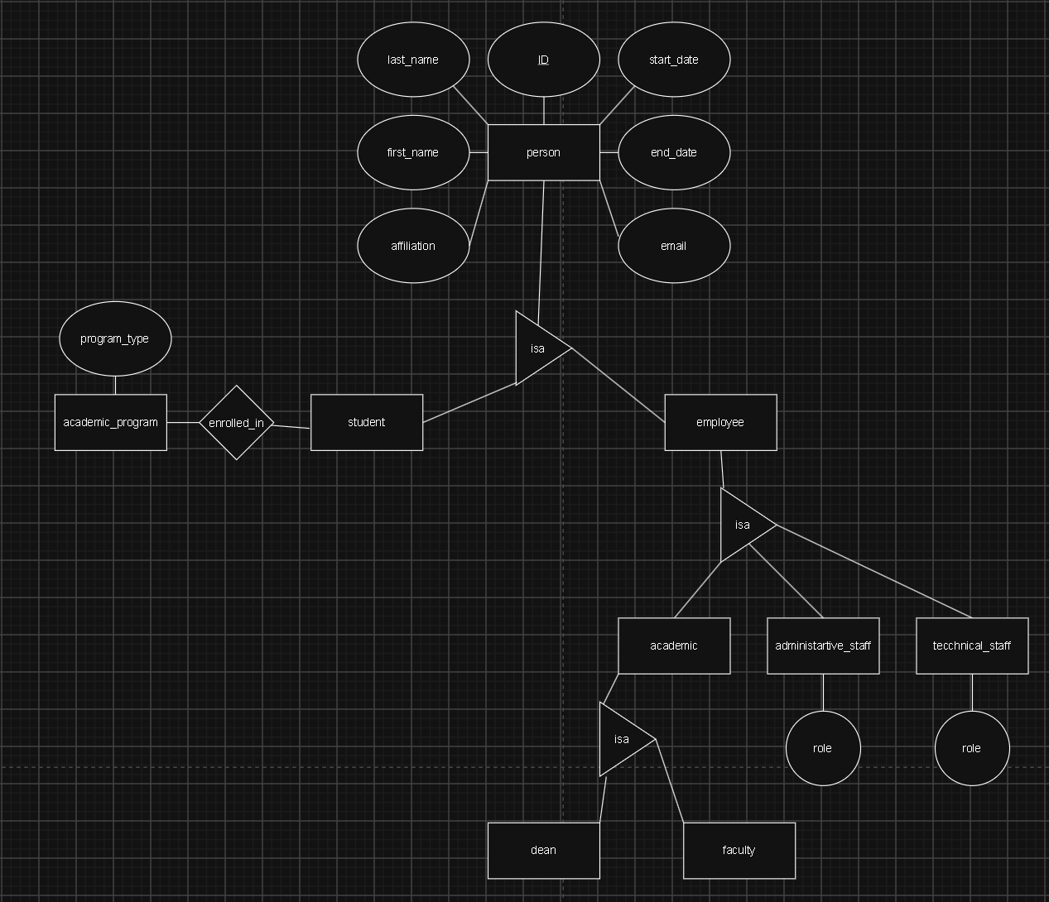
PERSON

Slide 8
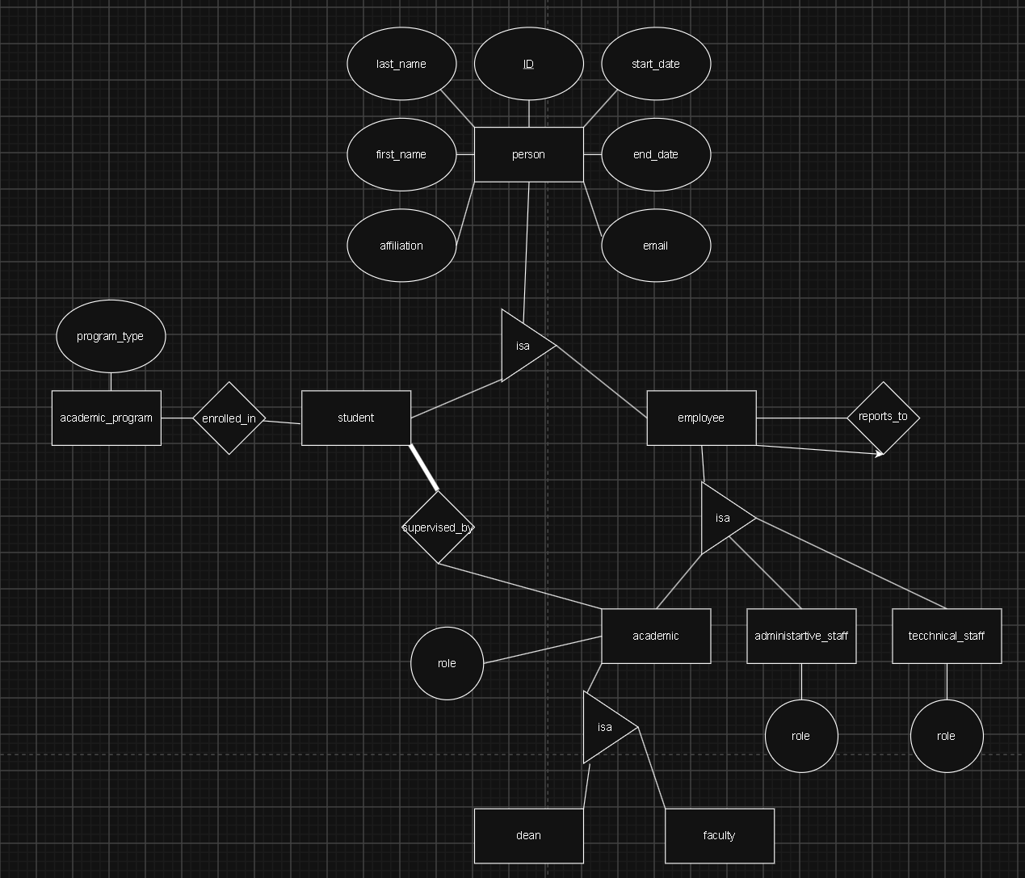
PERSON

Slide 9
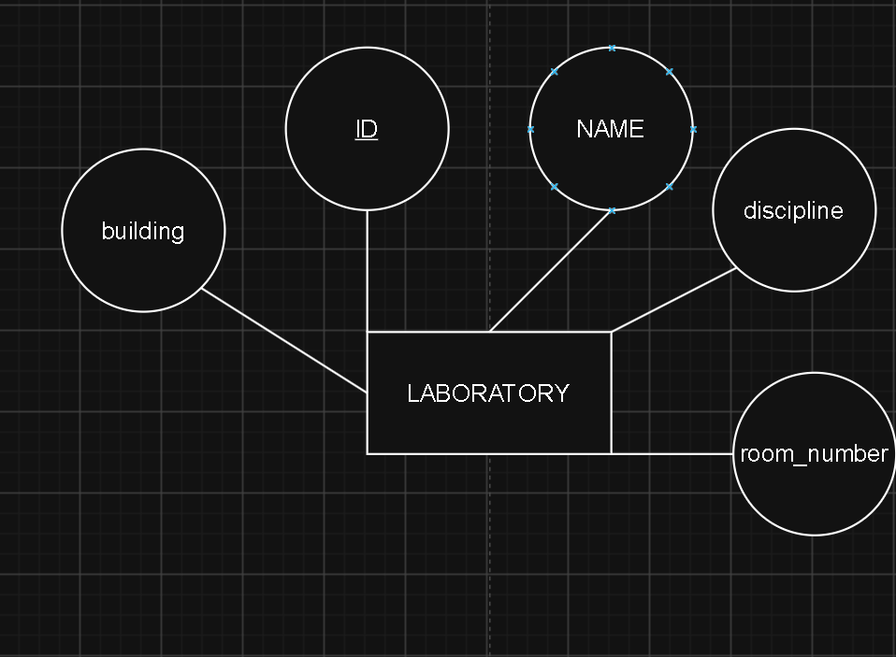
LABORATORIES

Slide 10
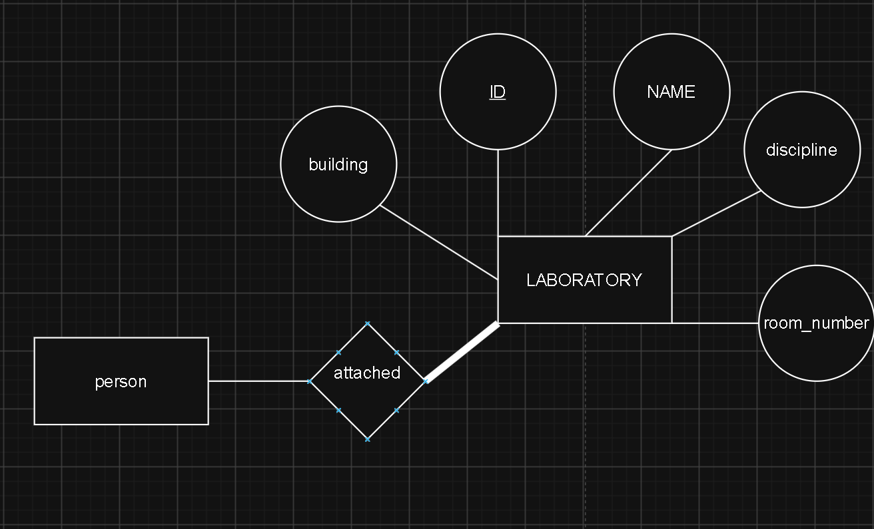
LABORATORIES

Slide 11
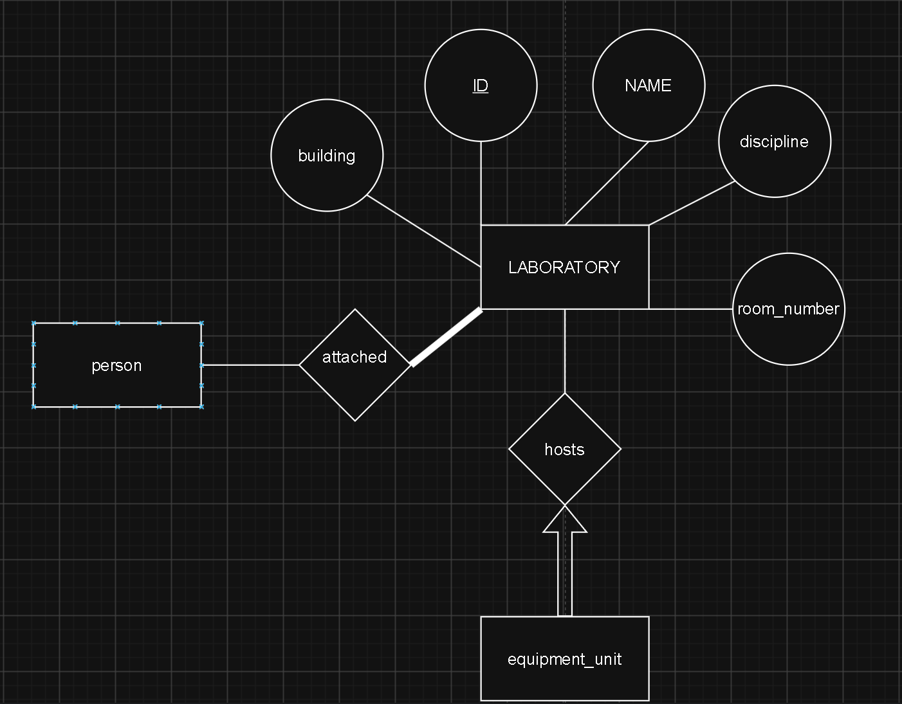
LABORATORIES

Slide 12
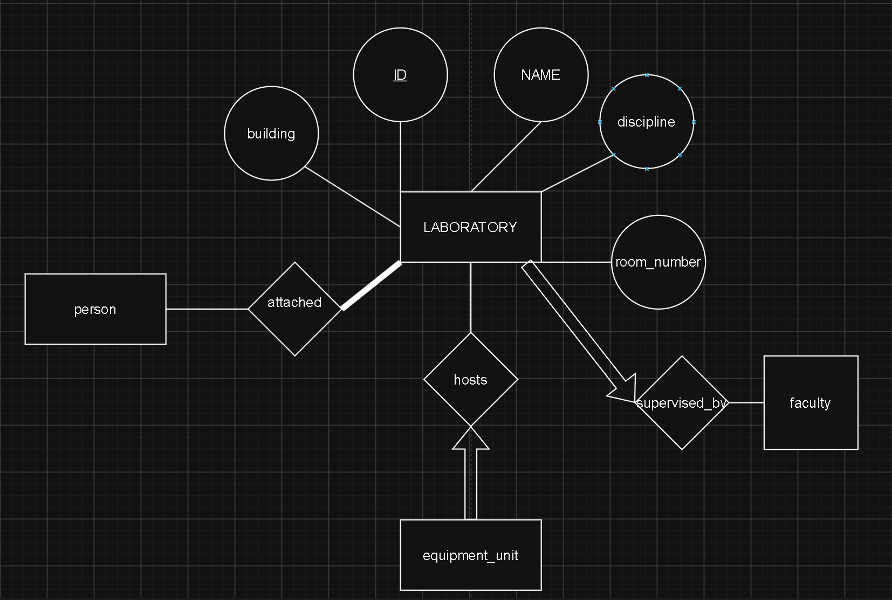
LABORATORIES

Slide 13
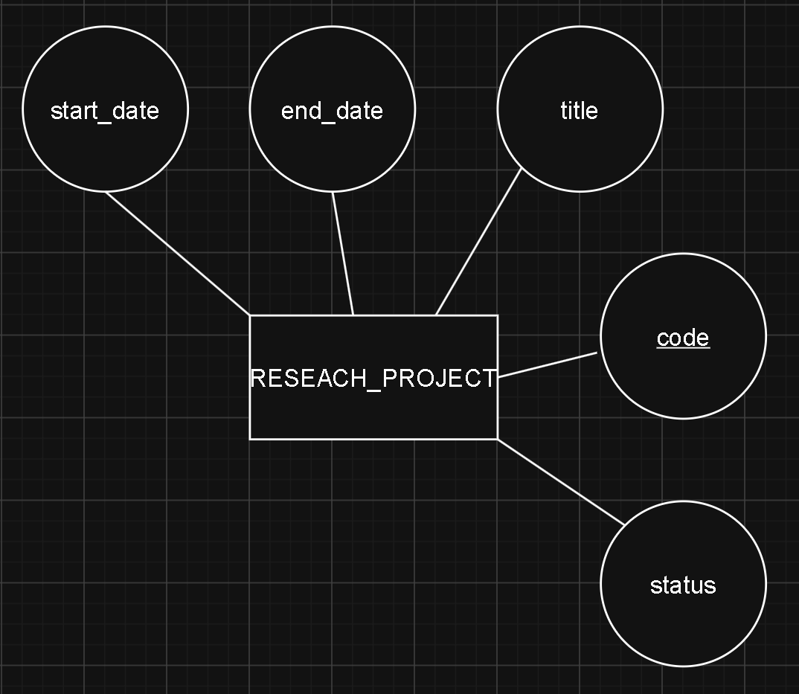
RESEARCH PROJECT

Slide 14
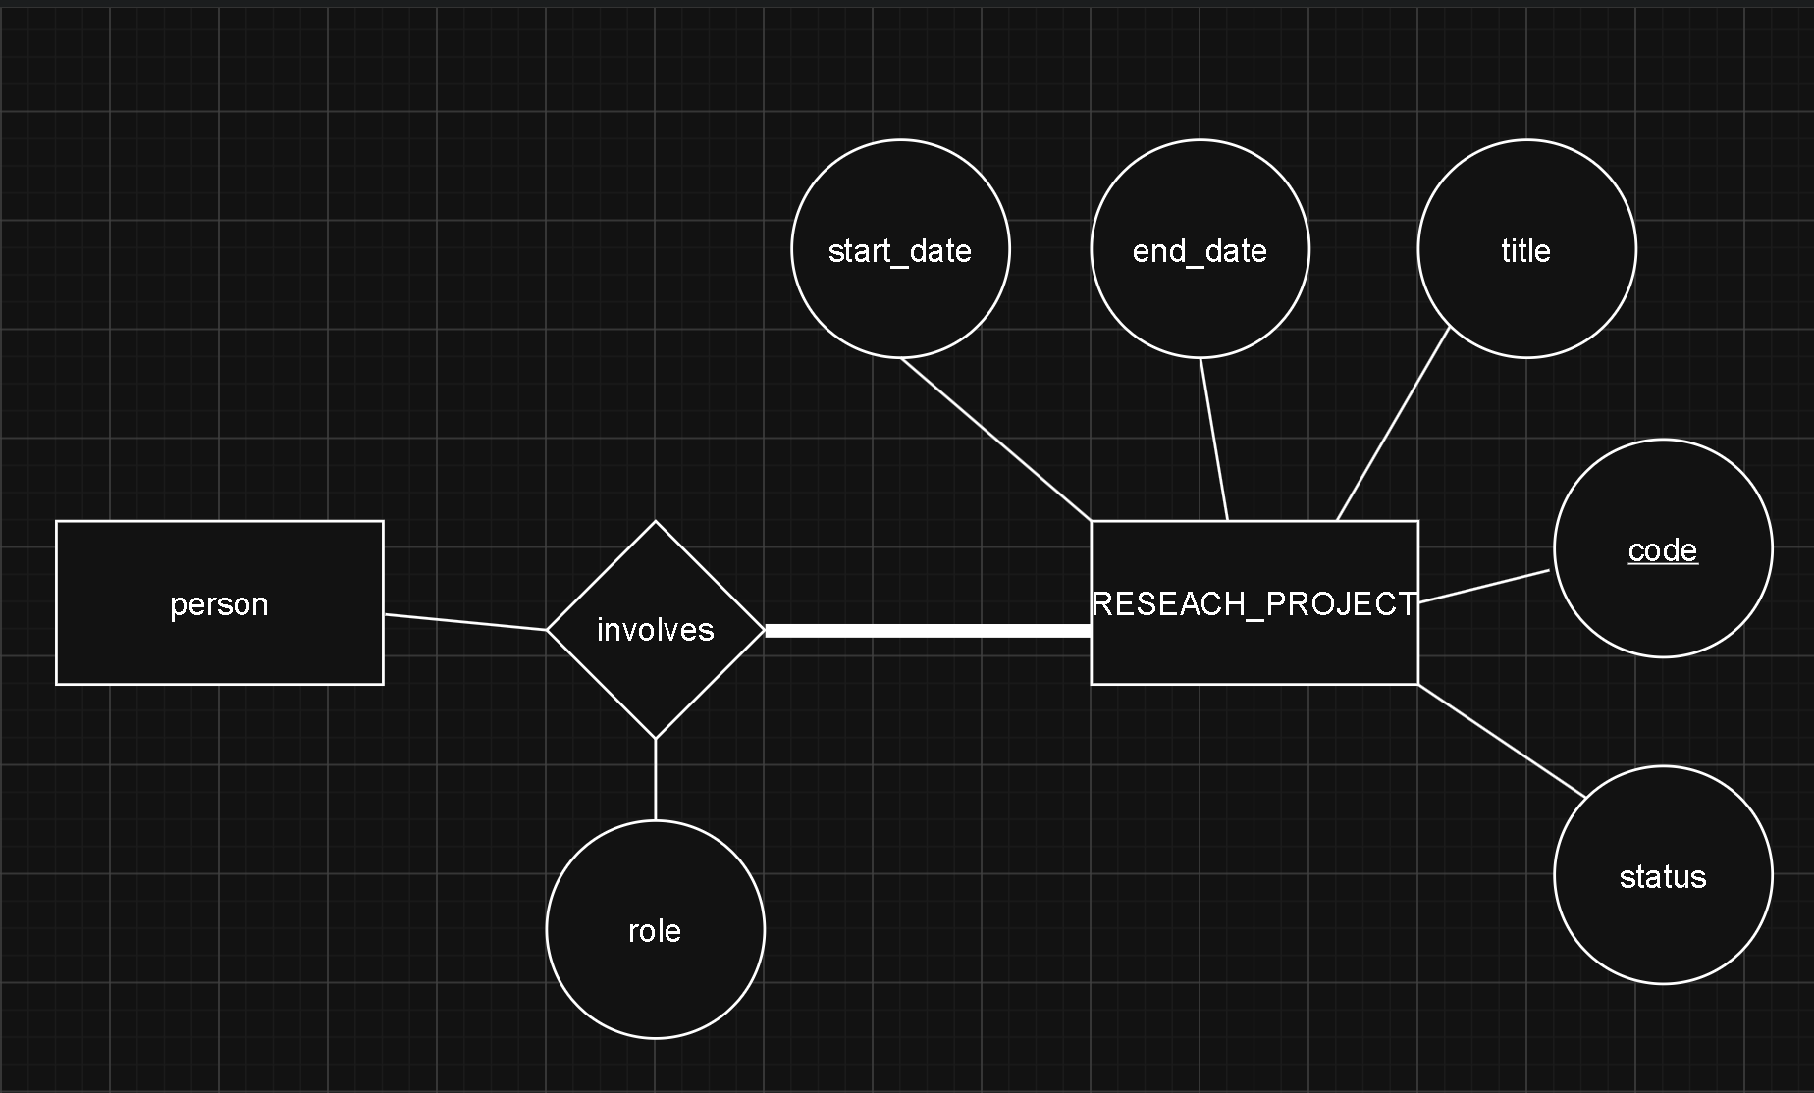
RESEARCH PROJECT

Slide 15
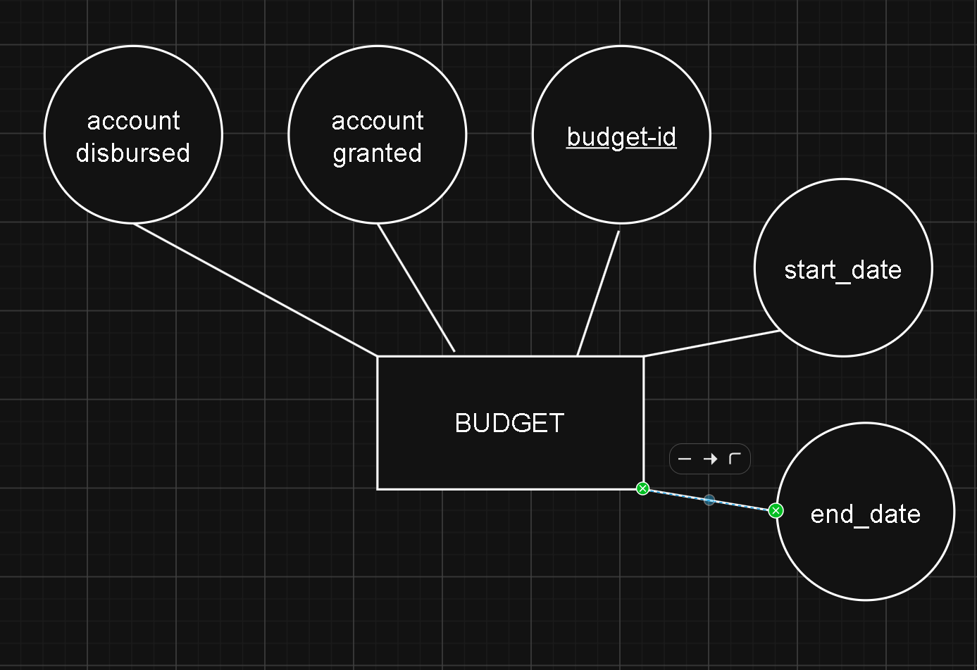
budget

Slide 16
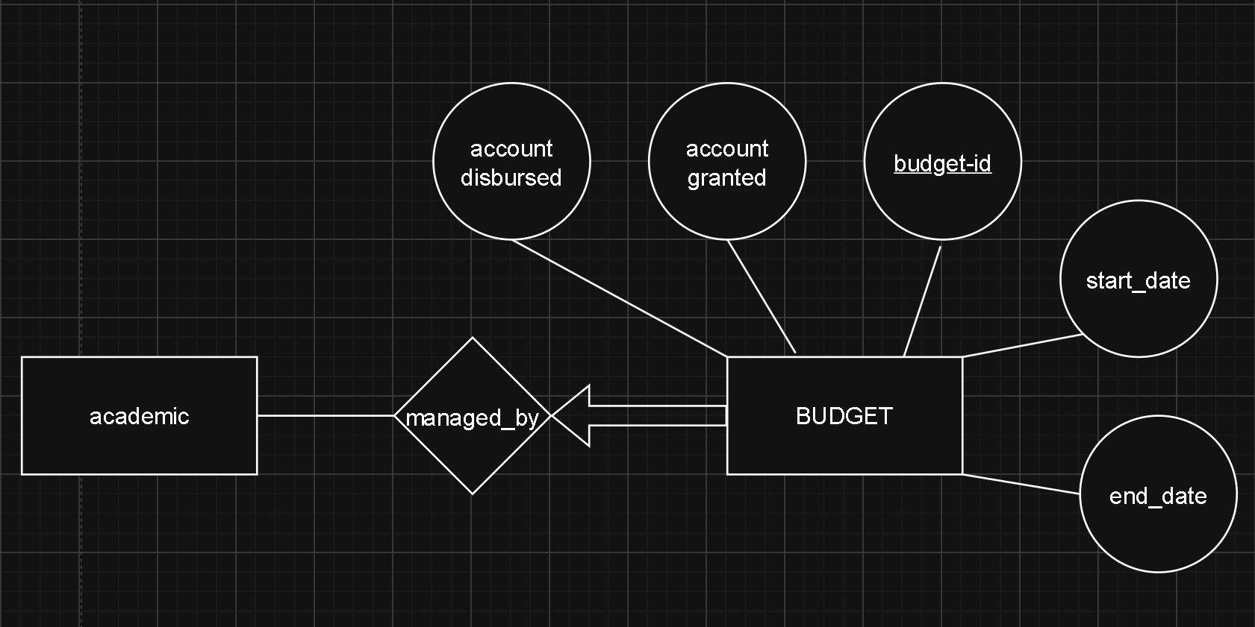
budget

Slide 17
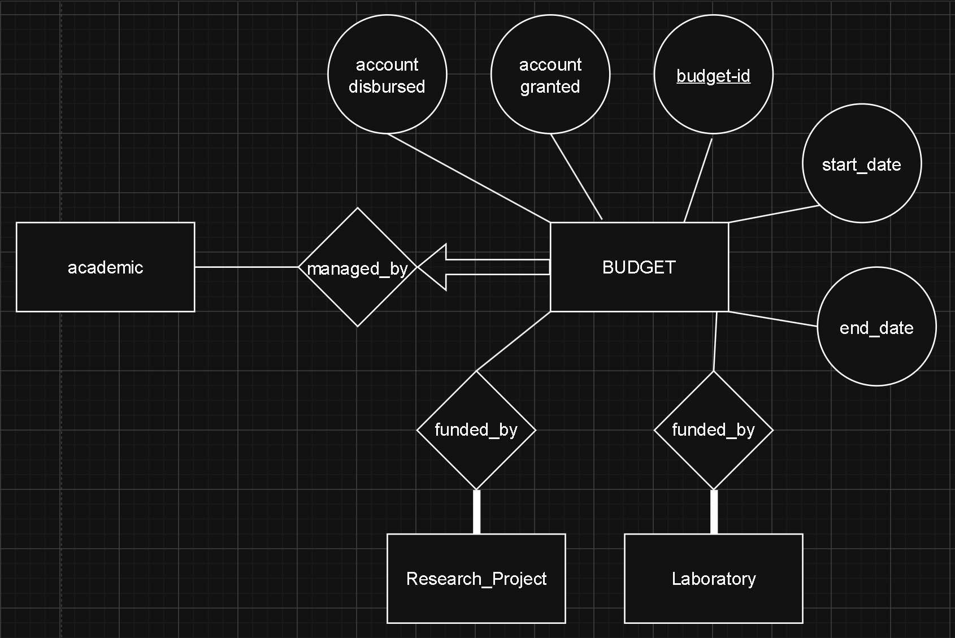
budget

Slide 18
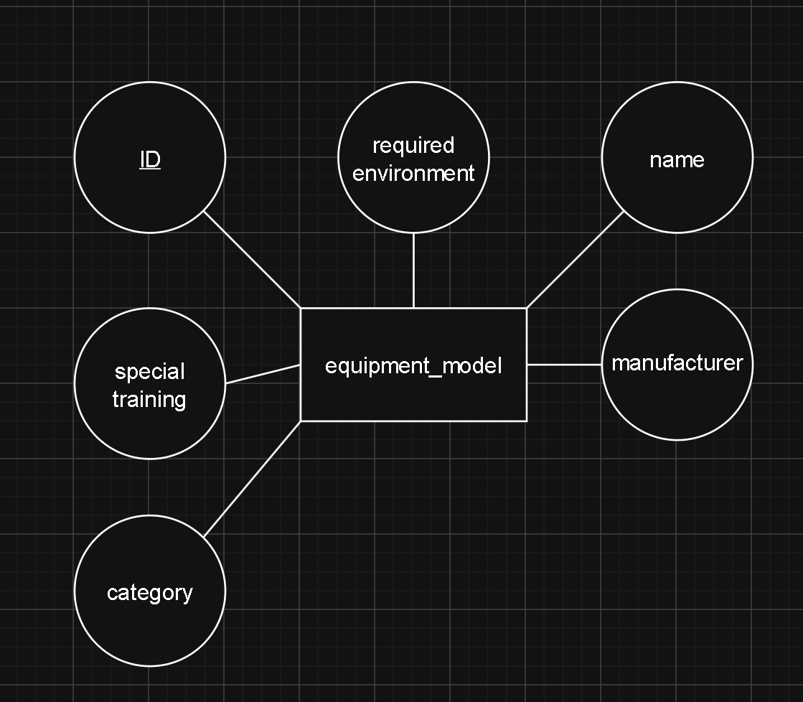
EQUIPMENT MODELS AND EQUIPMENT UNITS

Slide 19
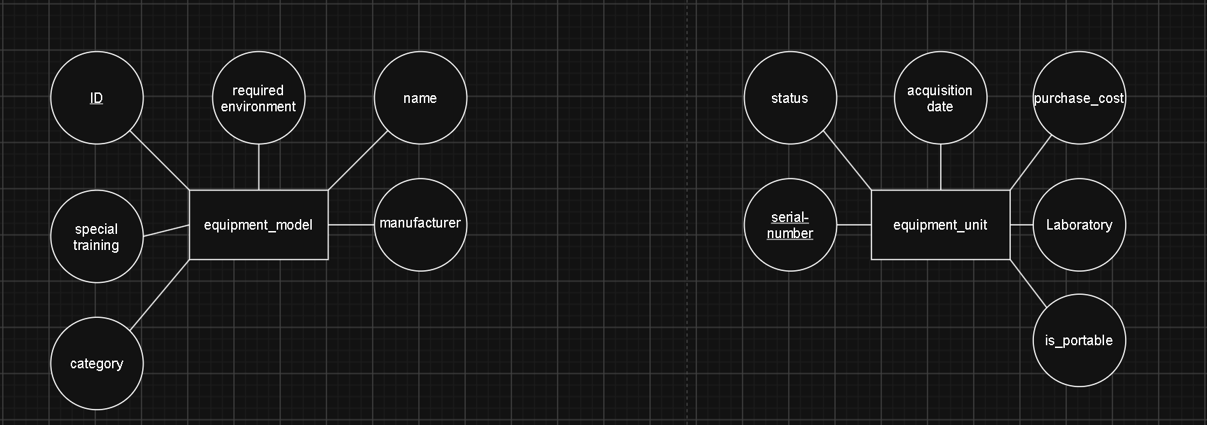
EQUIPMENT MODELS AND EQUIPMENT UNITS

Slide 20
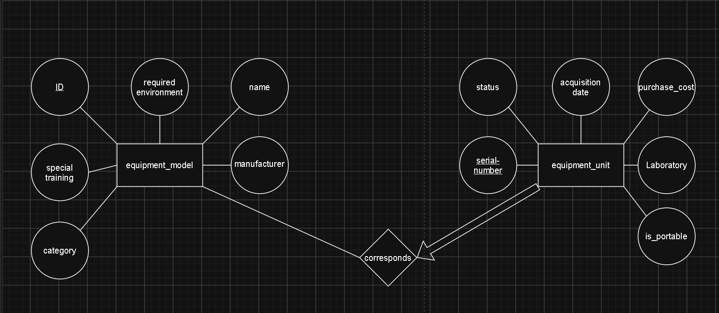
EQUIPMENT MODELS AND EQUIPMENT UNITS

Slide 21
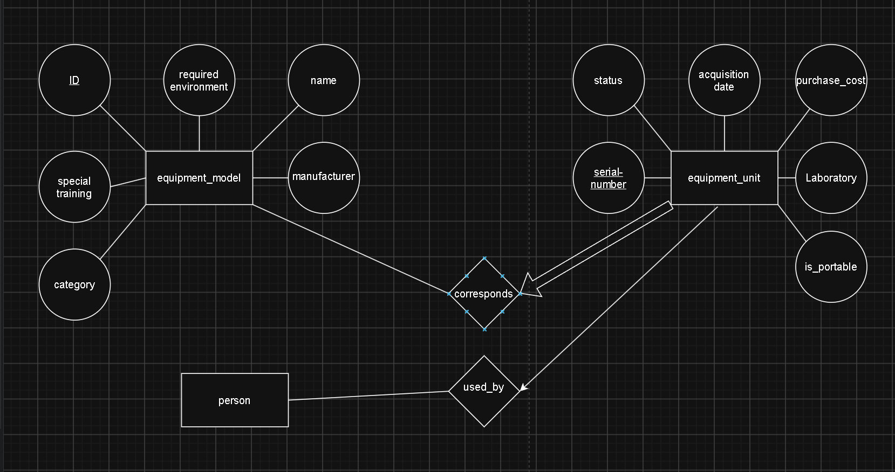
EQUIPMENT MODELS AND EQUIPMENT UNITS

Slide 22
EQUIPMENT MODELS AND EQUIPMENT UNITS

Slide 23
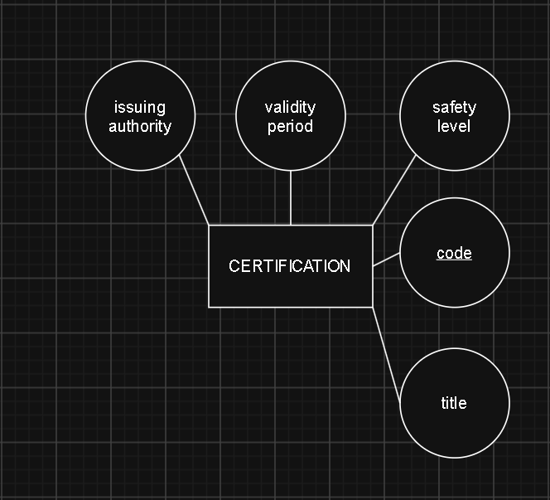
Certification and authorisation

Slide 24
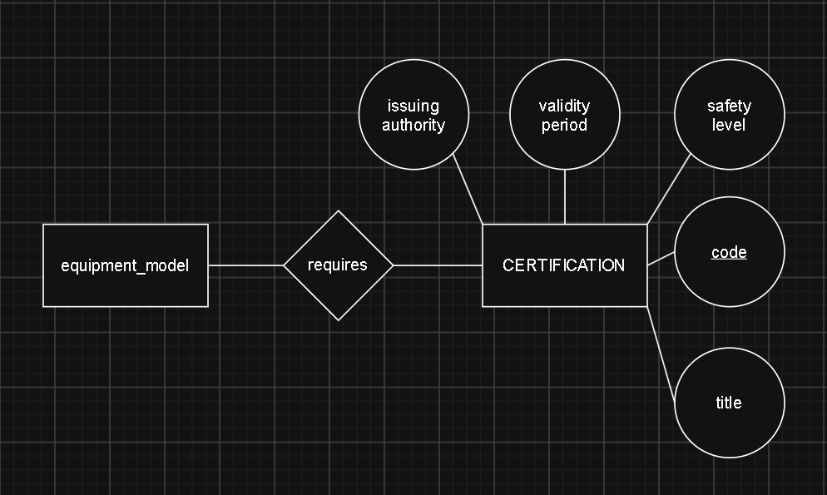
Certification and authorisation

Slide 25
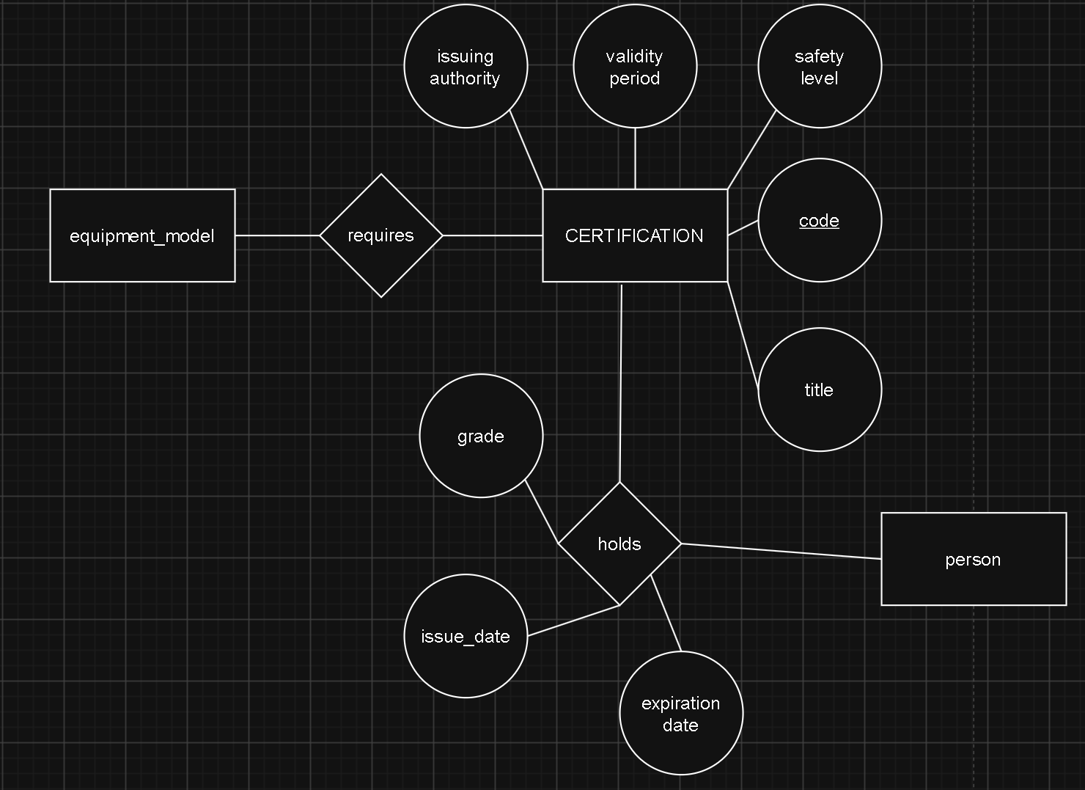
Certification and authorisation

Slide 26
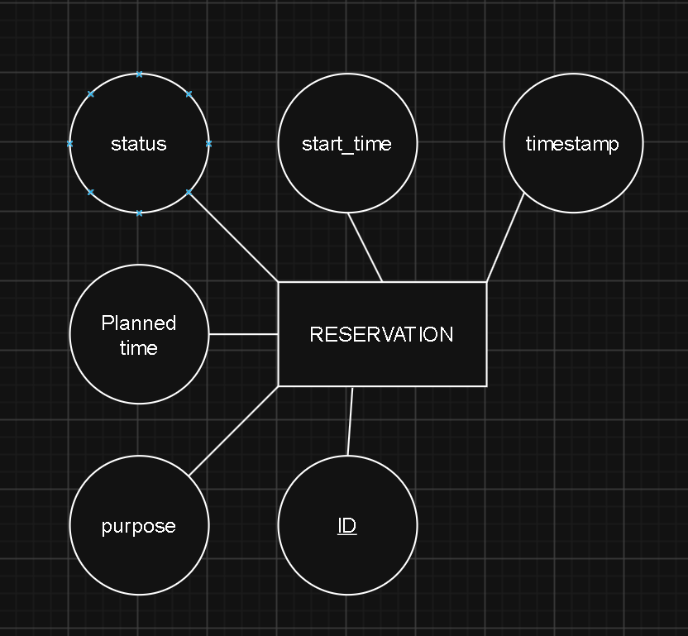
RESERVATION

Slide 27
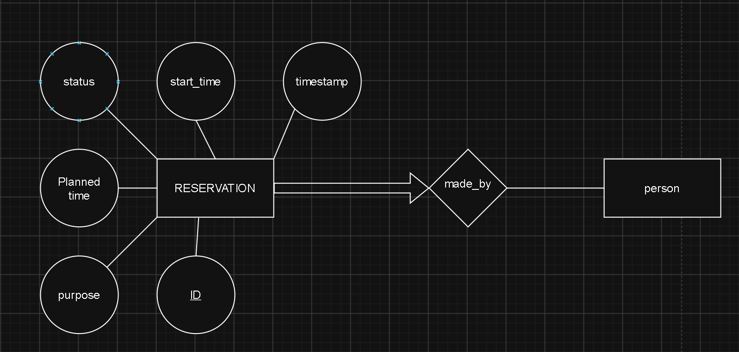
RESERVATION

Slide 28
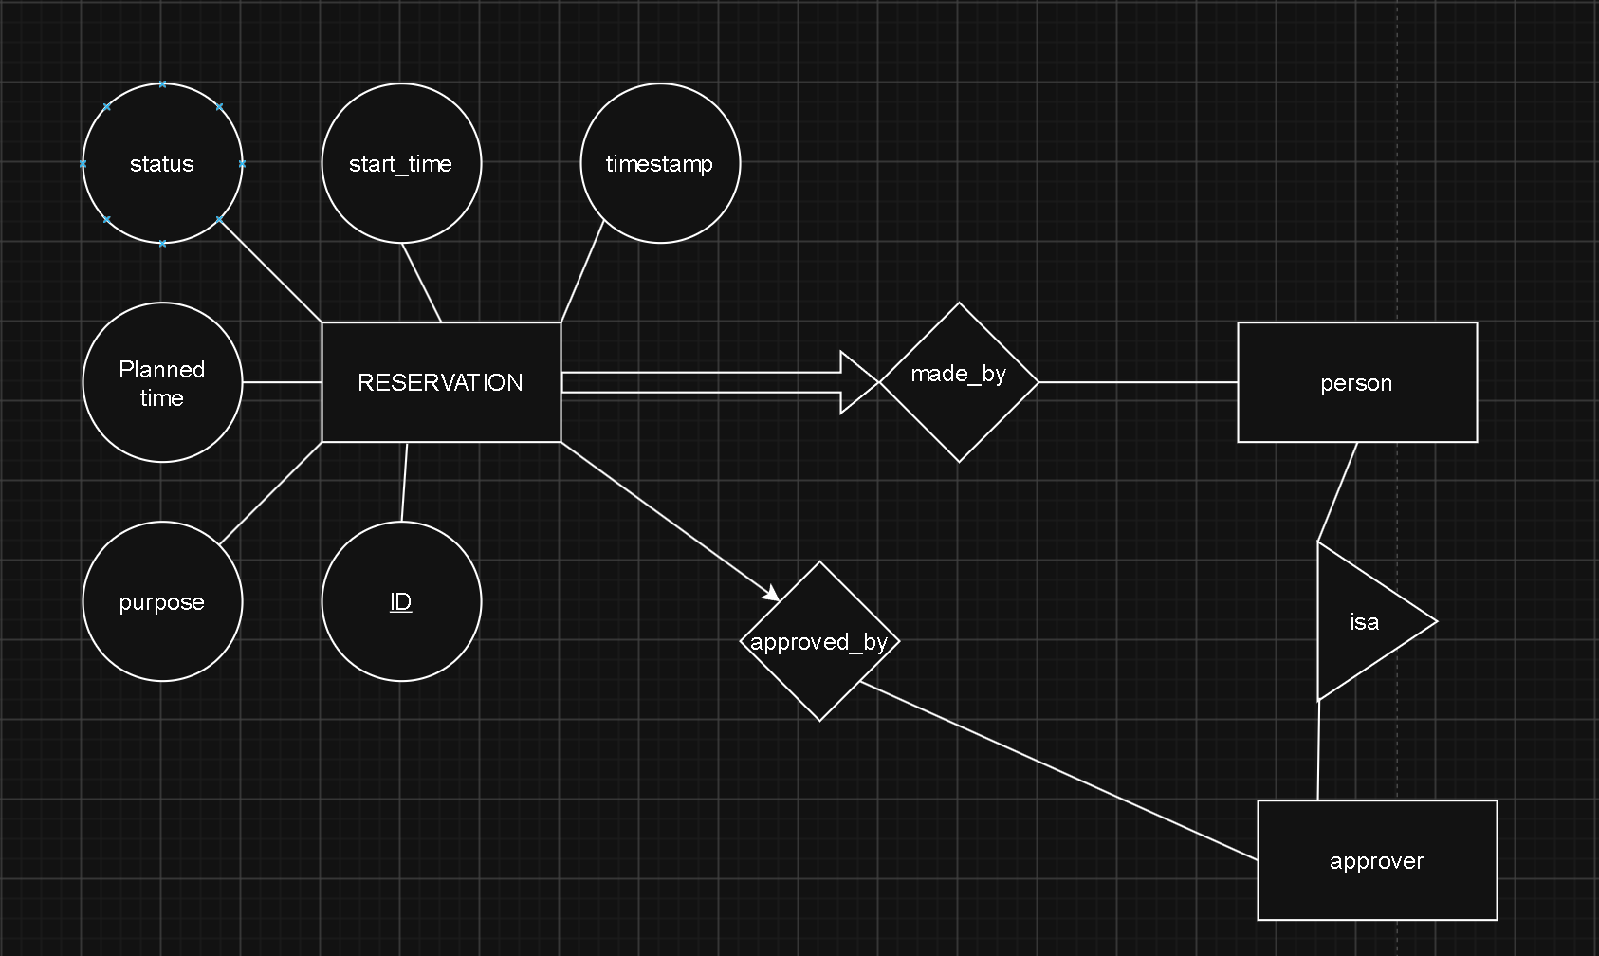
RESERVATION

Slide 29
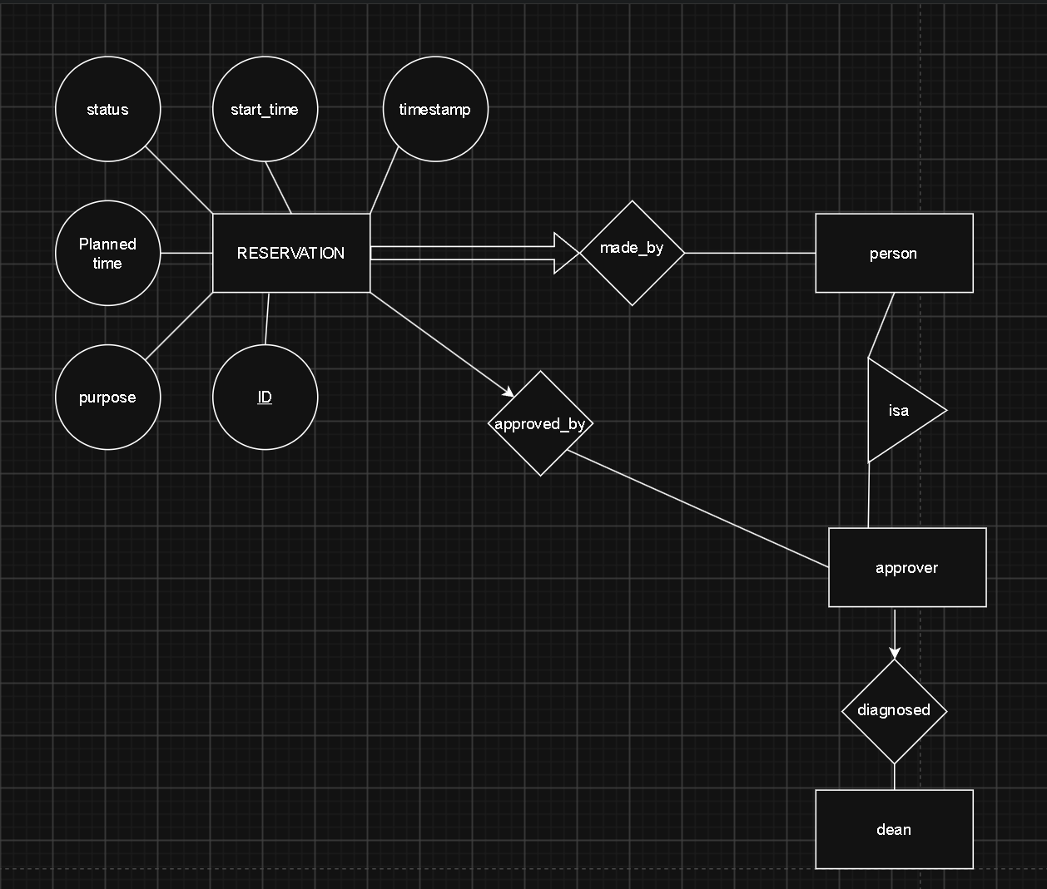
RESERVATION
Little typo here meant to write designated and not diagnosed.

Slide 30
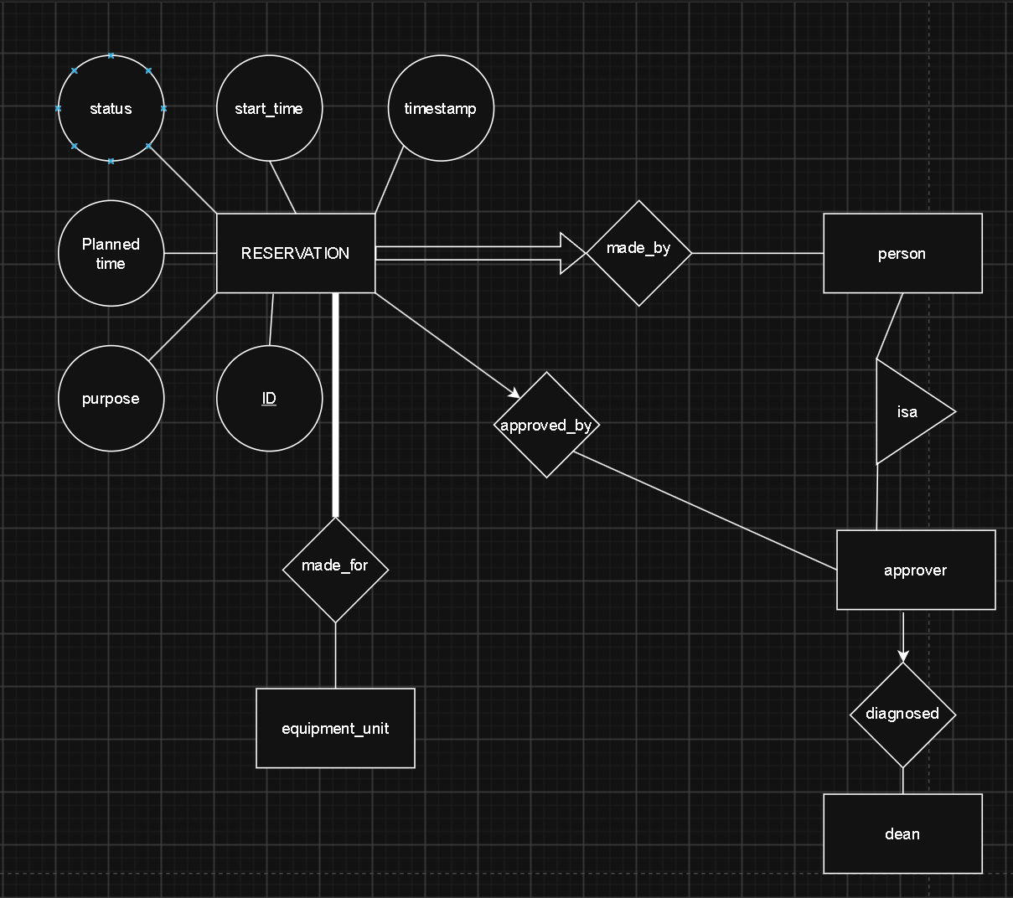
RESERVATION

Slide 31
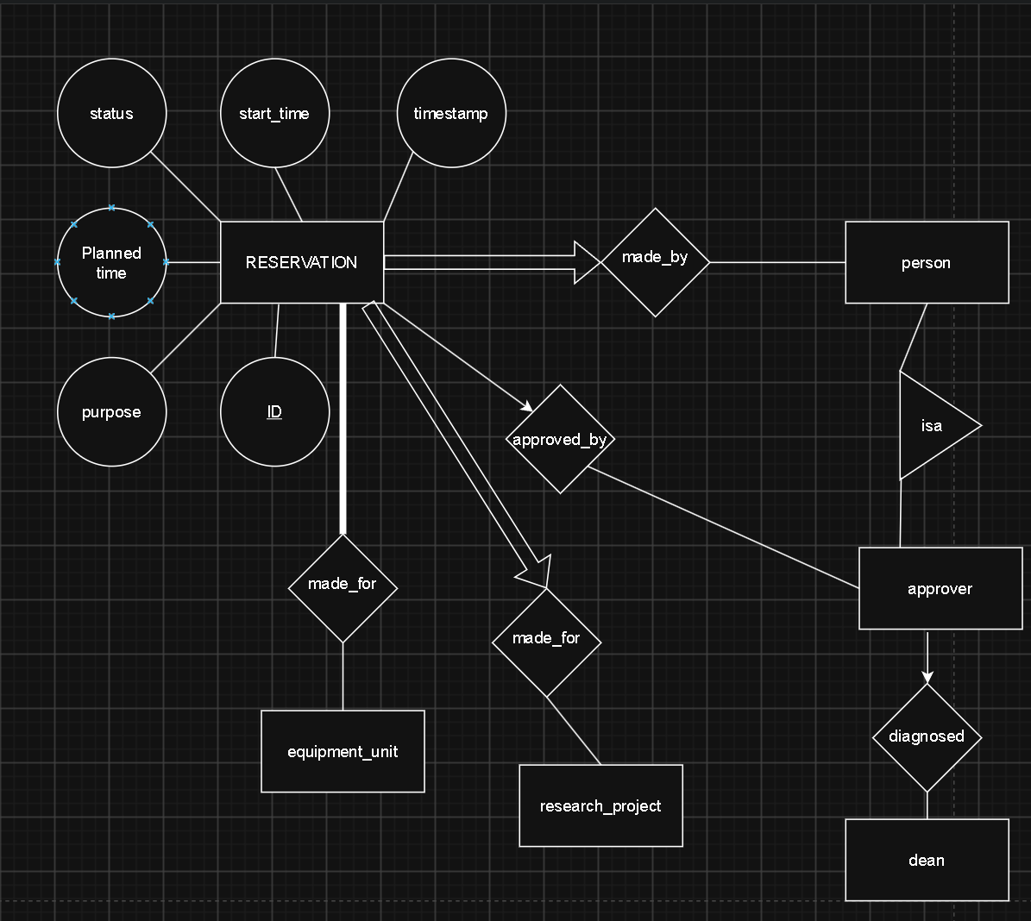
RESERVATION

Slide 32
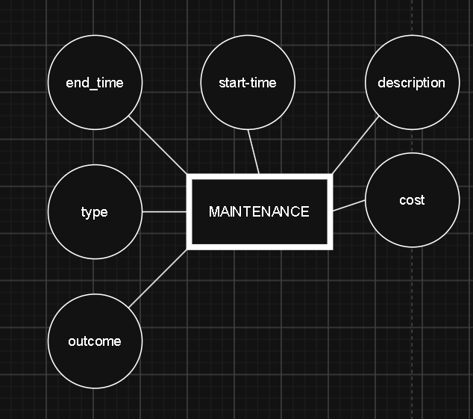
MAINTENANCE

Slide 33
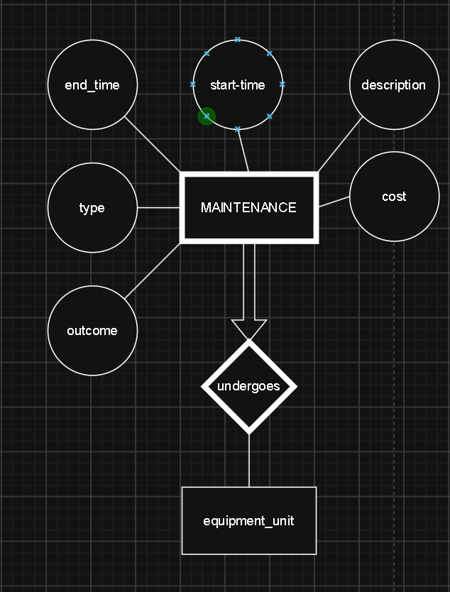
MAINTENANCE

Slide 34
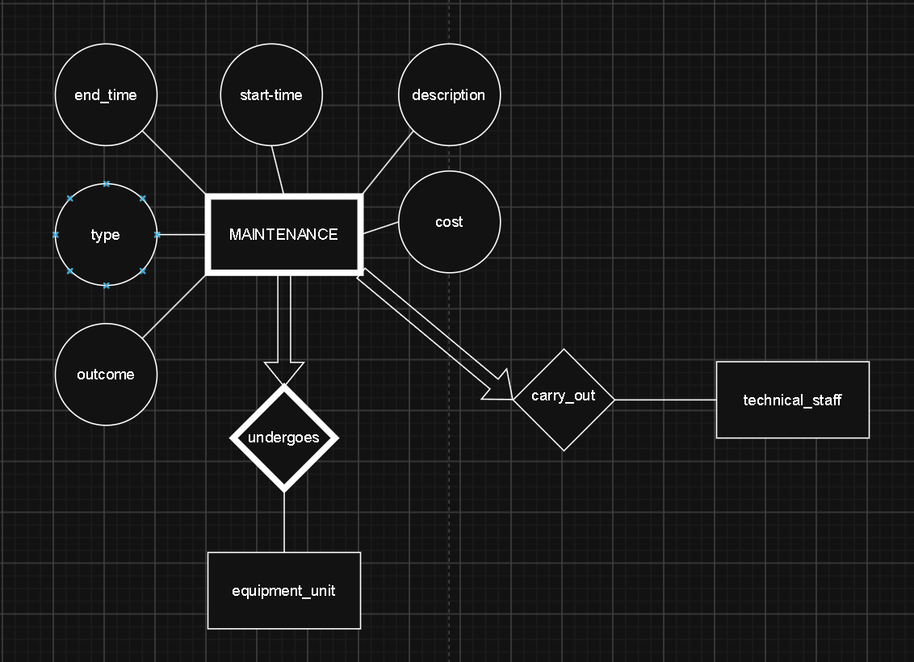
MAINTENANCE

Slide 35
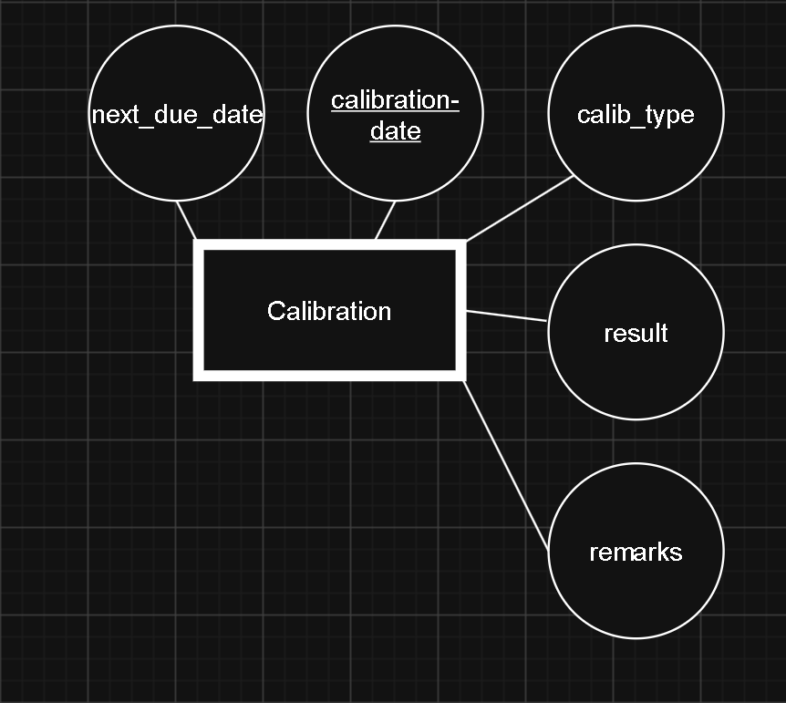
Calibration records

Slide 36
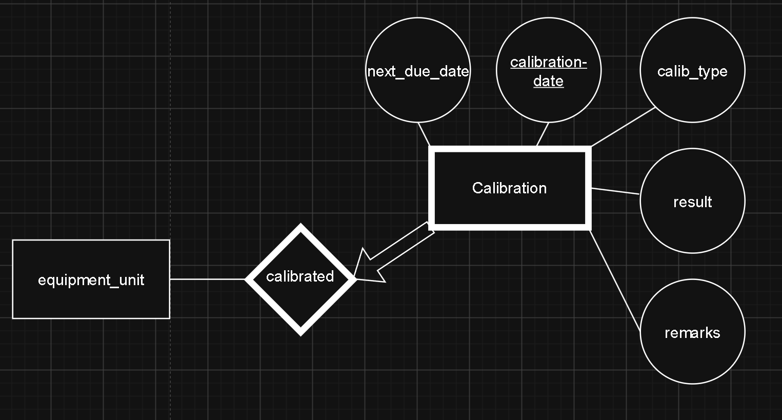
Calibration records

Slide 37
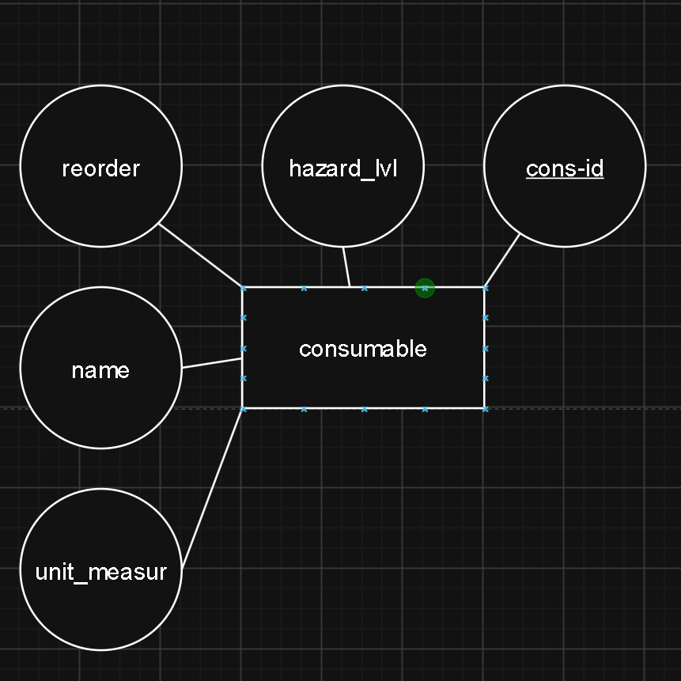
consummable

Slide 38
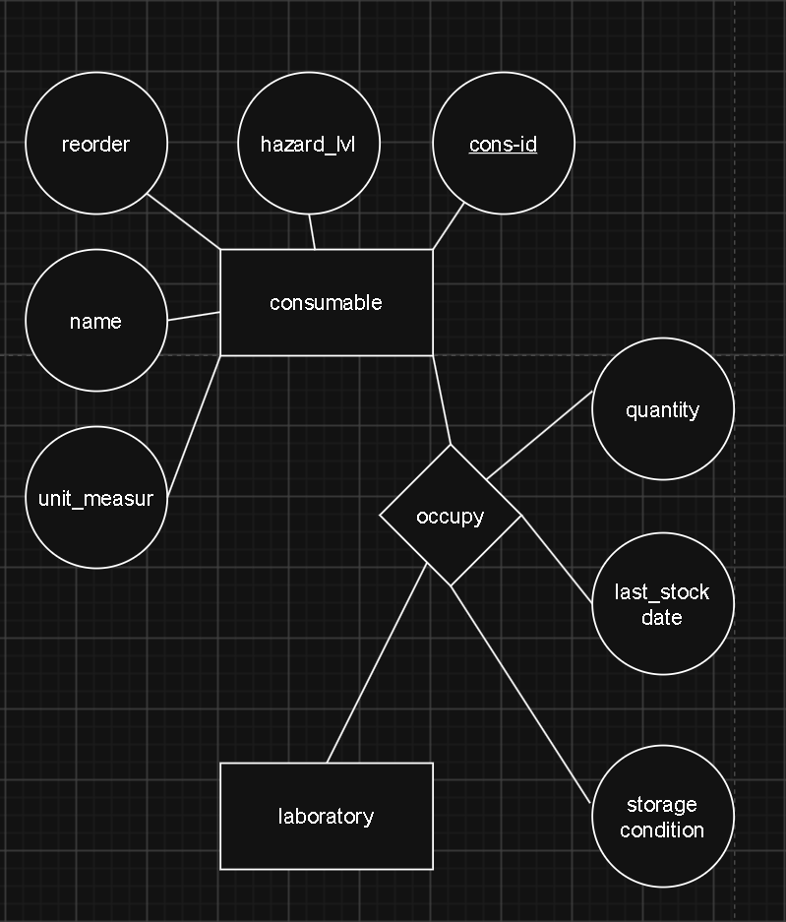
consummable

Slide 39
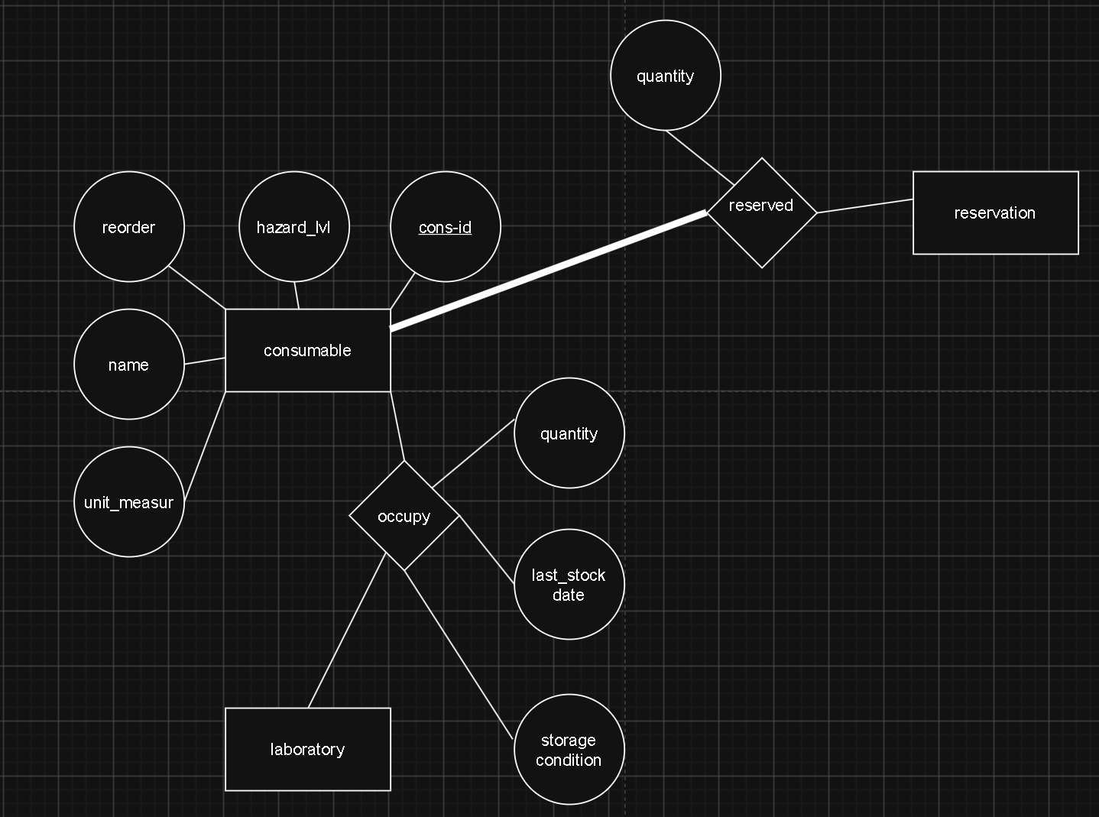
consummable

Slide 40
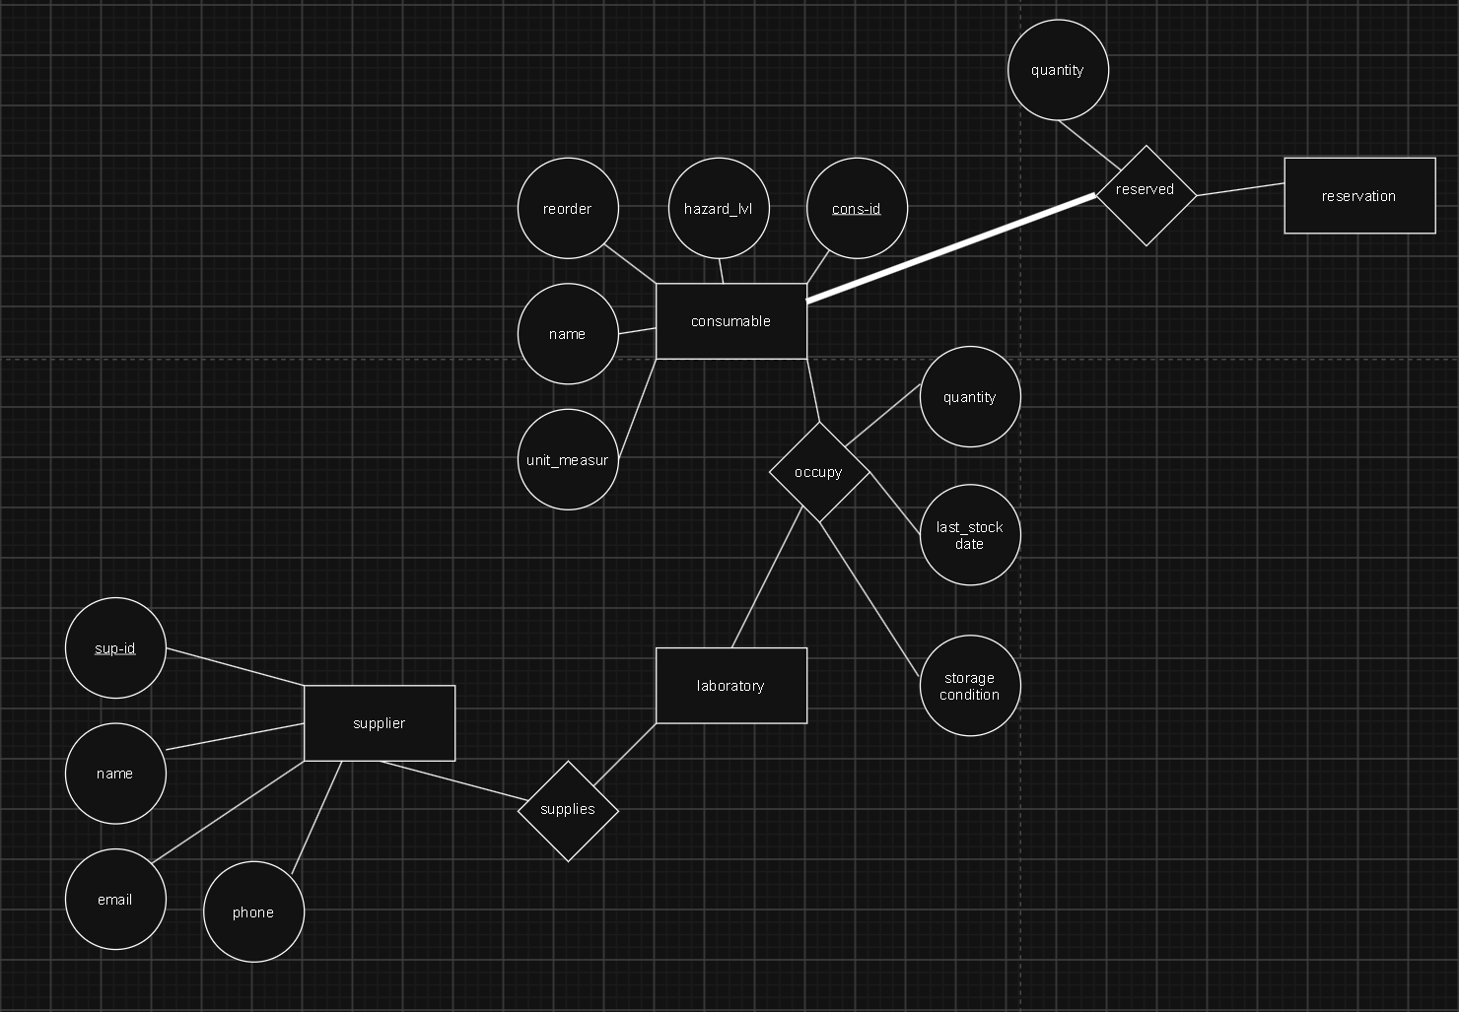
consummable

Slide 41
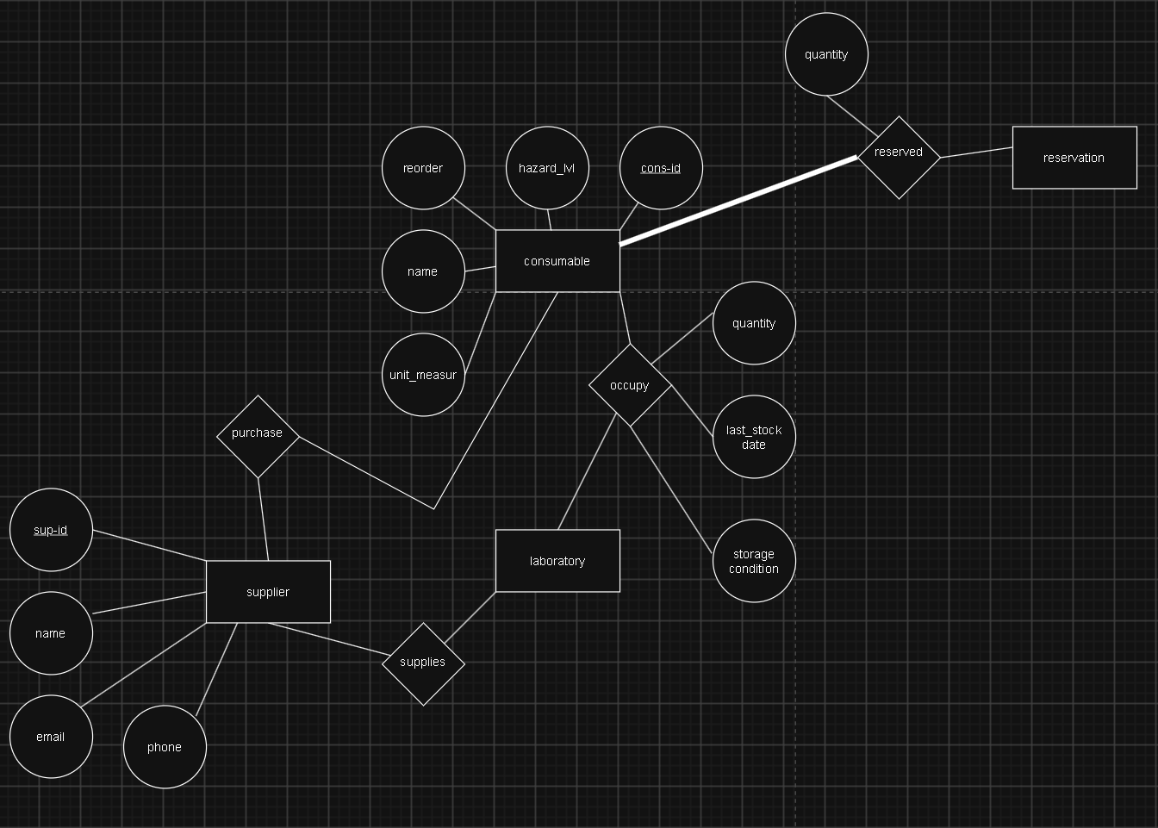
consummable

Slide 42
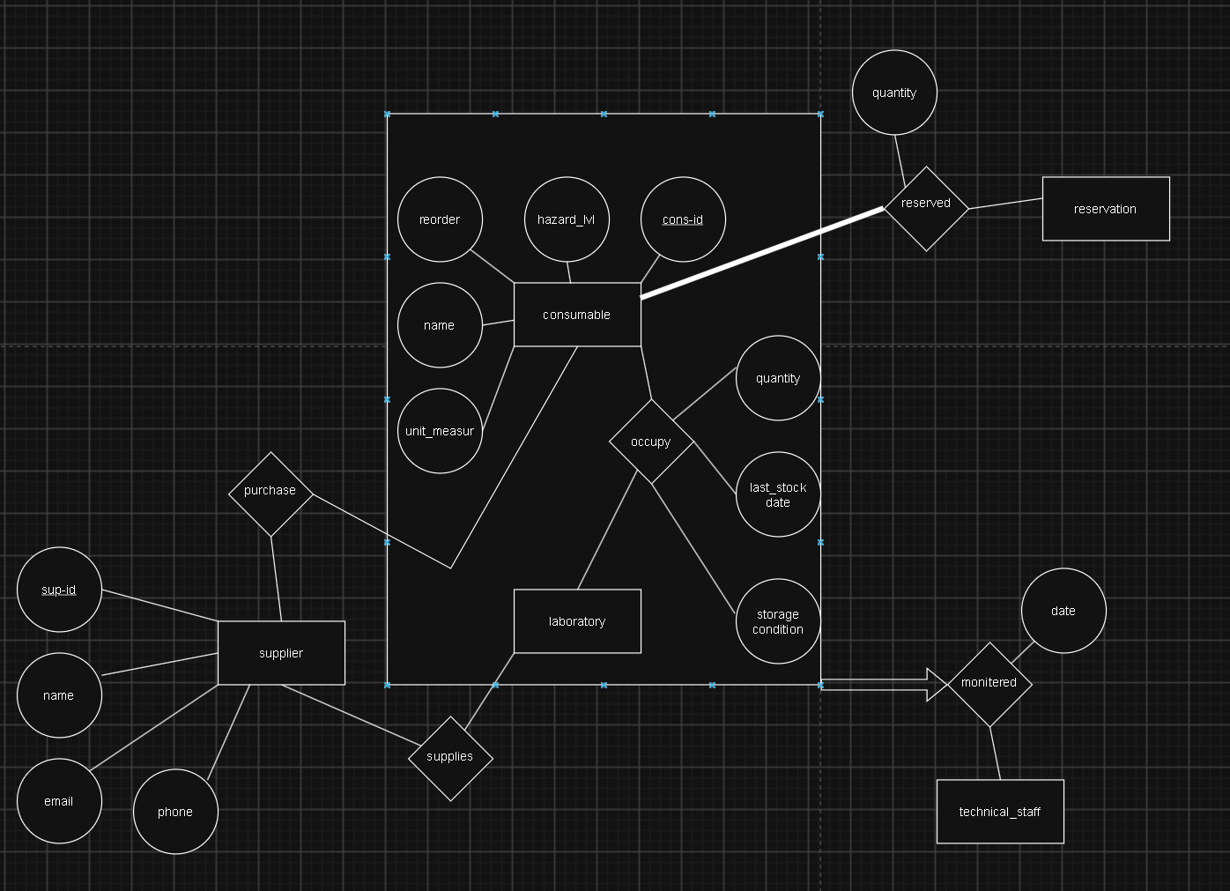
consummable

Slide 43
AND NOW THE MERGED RESULT
Note: in order to keep things clean, some of the attributes were not included in the final design

Slide 44
